Slide 1
PROJECT (PHASE - I)

Slide 2
PROJECT (PHASE - I)
Prepare the document relevant to your project:
  Understand the problem statement
  Project definition: Create a document on what have you understood
  Design thinking: Create a document how will you proceed ahead with solving the problem.
Note: You can create a word doc, pdf, or powerpoint presentation as you like (explaining all the details as needed.)
File Naming Convention: IOT Phase1

Slide 3
PROJECT (PHASE - I)
After completion
upload your file to your private GitHub account.

Slide 4
CREATE GITHUB ACCOUNT
(a) Every student should Create an account in github
Video link: https://www.youtube.com/watch?v=kPQ9bsFzN7Q
Time to watch: 18:00 to 31.20

Slide 5
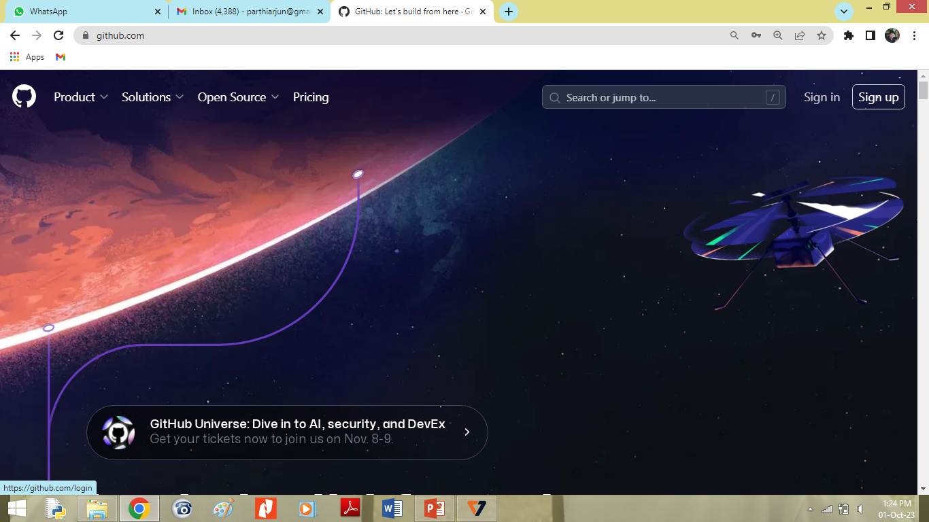

Slide 6
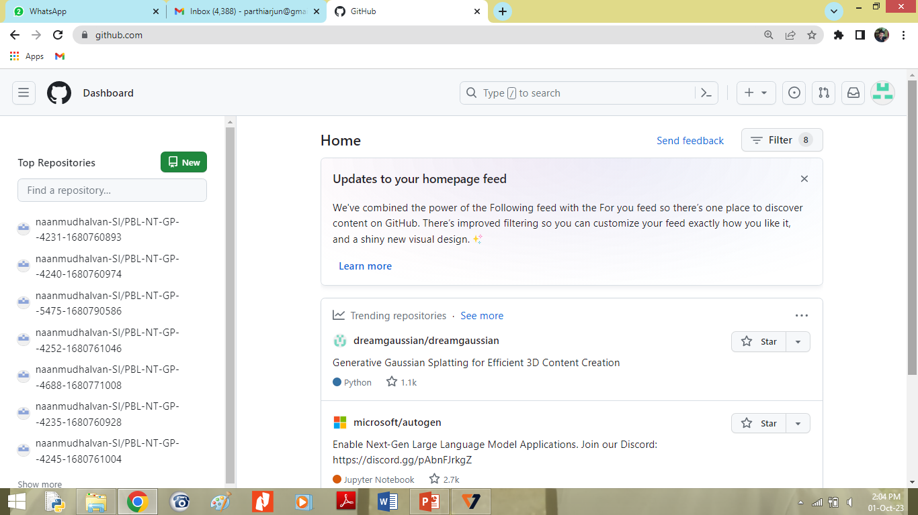
CREATE GITHUB ACCOUNT
(b) Create a Repository (i.e., Folder) in github

Slide 7
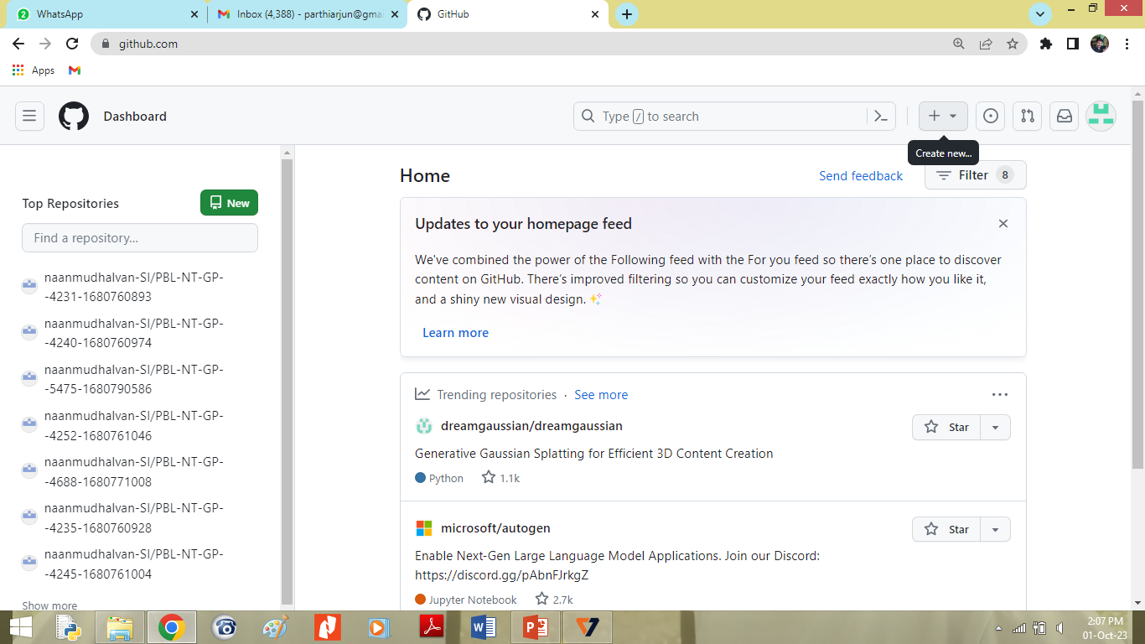
Create a Repository (i.e., Folder) in github
Click on the ‘+’ logo i.e., Create New

Slide 8
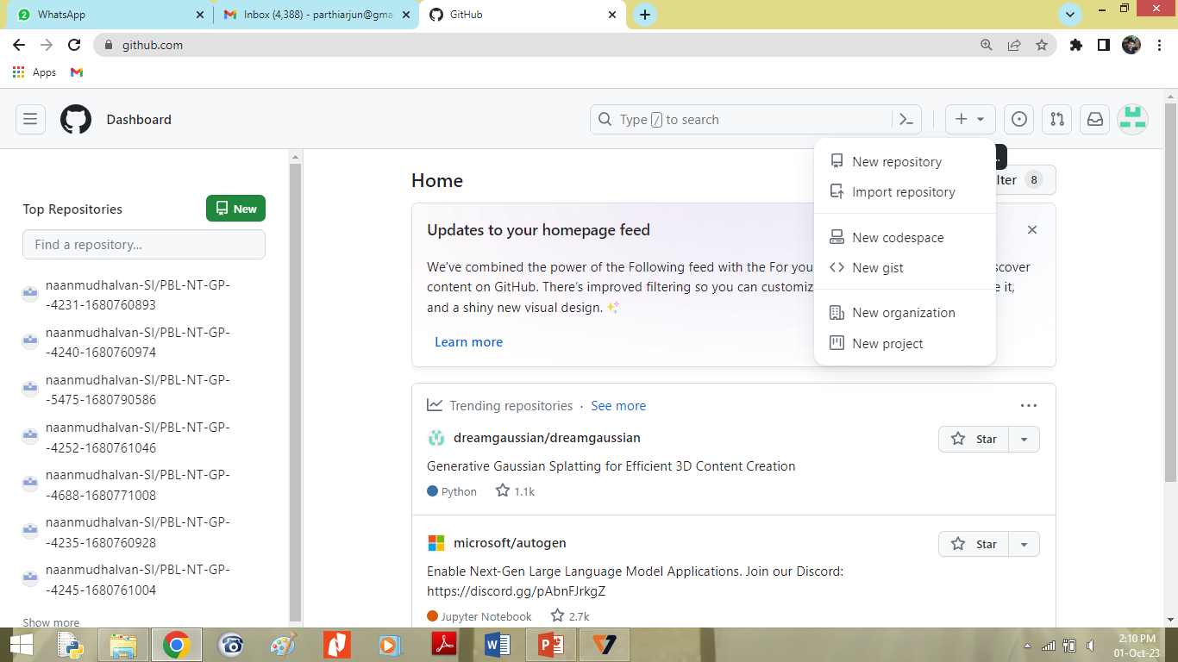
Create a Repository (i.e., Folder) in github
Click on ‘New repository’

Slide 9
Create a Repository (i.e., Folder) in github
Give ‘Repository name’
Type something about project in ‘Description’
Mark ‘Public’
Tick ‘Add a README file’

Slide 10
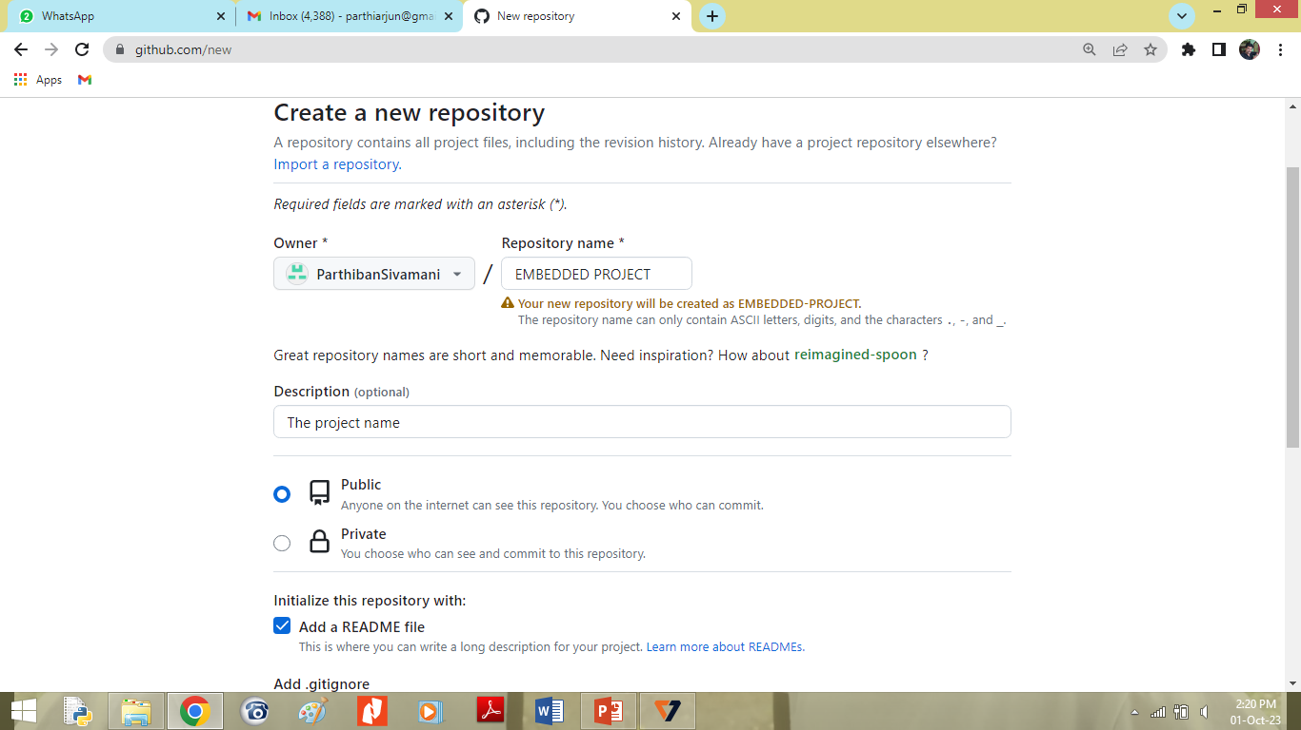
Create a Repository (i.e., Folder) in github
Scroll down

Slide 11
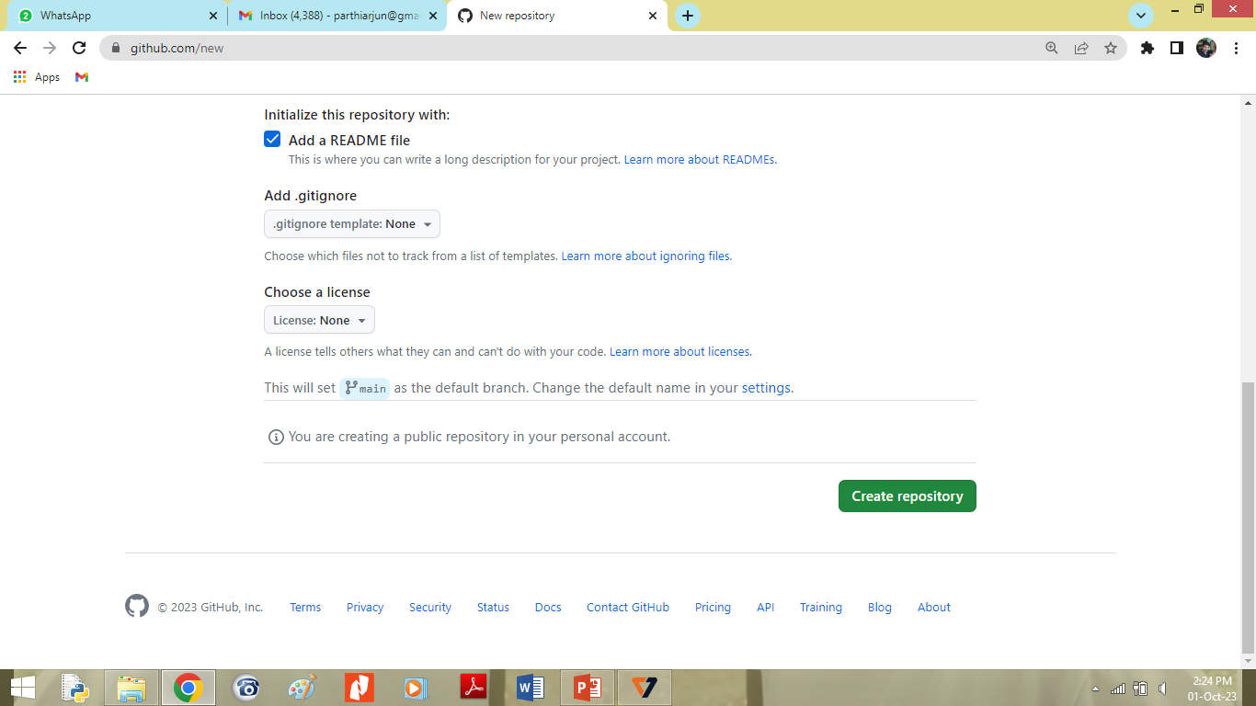
Create a Repository (i.e., Folder) in github
Click on ‘Create repository’

Slide 12
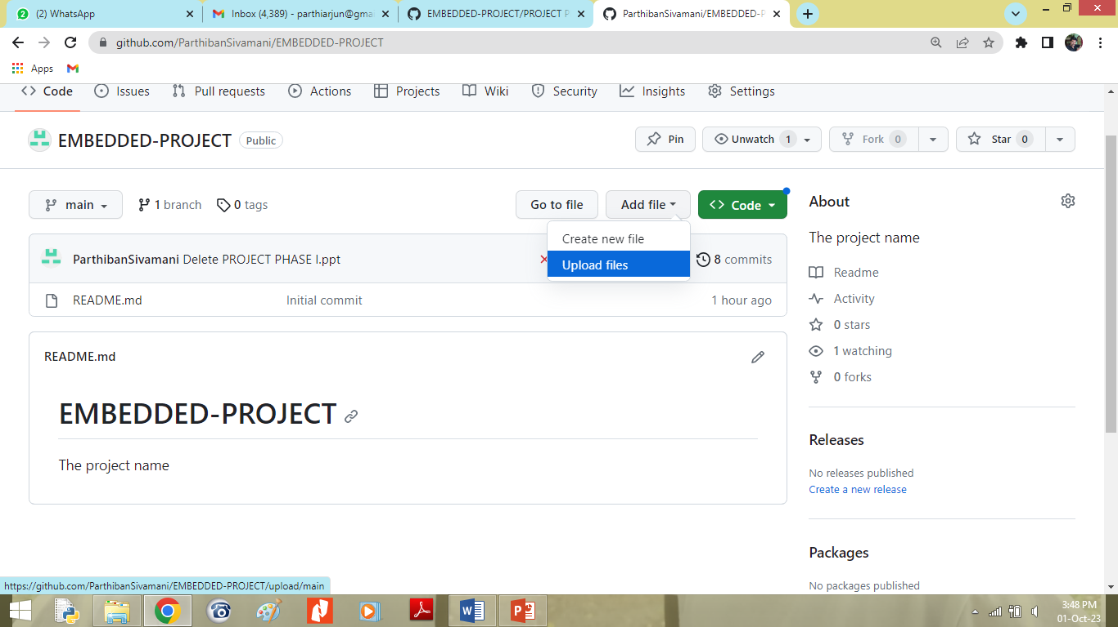
Create a Repository (i.e., Folder) in github
Click on the ‘Add file’ then ‘Upload files’

Slide 13
Create a Repository (i.e., Folder) in github
Choose your document from your system or drag your document to upload

